Slide 1
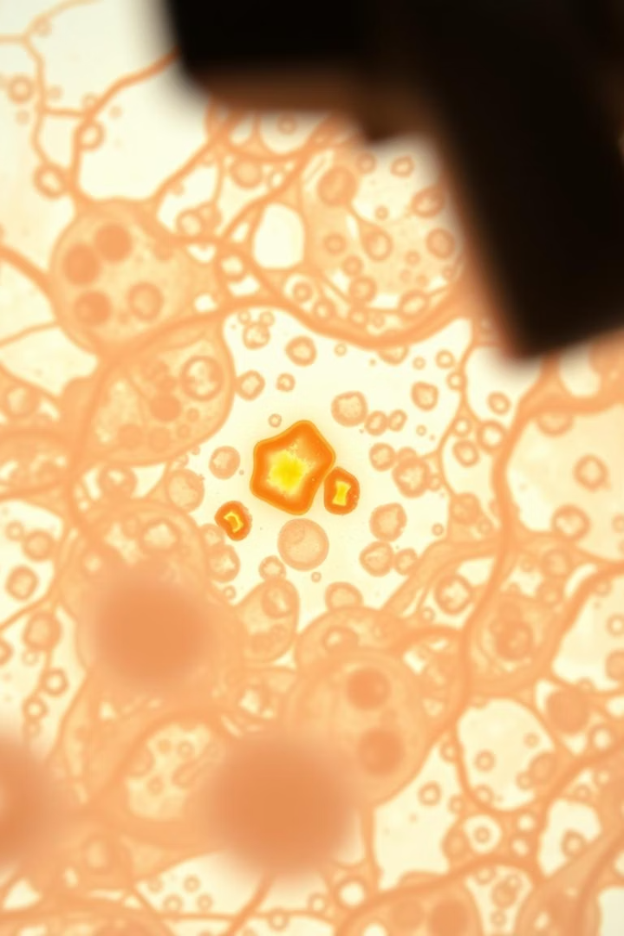
Interpretable Cervical Cancer Detection with Class Activation Maps
Discover how Class Activation Maps (CAMs) reveal CNN decisions in cervical cancer detection.
They enhance trust and transparency in AI-driven diagnostics for critical healthcare.

Slide 2
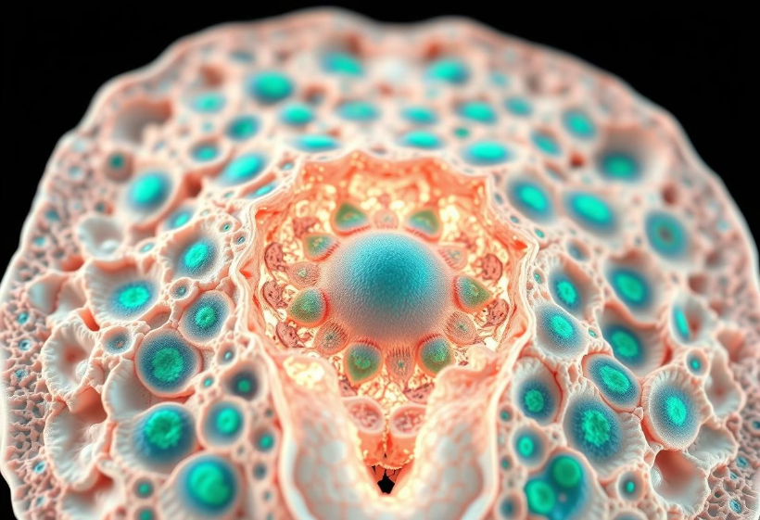
Introduction to Convolutional Neural Networks (CNNs)
CNNs use convolution, pooling, and activation layers to extract features.
They automate cervical cancer screening with accuracy above 95%.
However, CNNs are often seen as “black boxes” with unclear decisions.

Slide 3
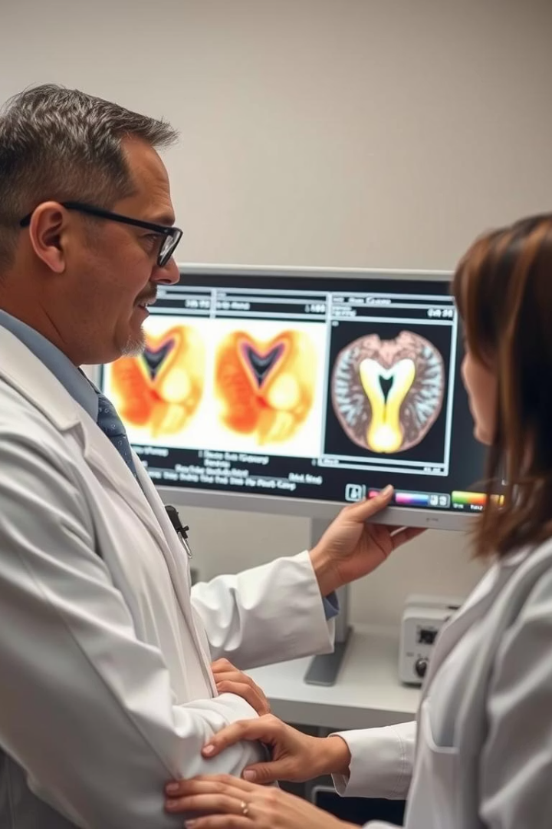
The Need for CNN Interpretation
Black Box Problem
CNN decisions are complex and opaque, hindering trust.
Clinician Trust
Visual explanations help build confidence in AI tools.
Detect Biases
Interpretation reveals dataset artifacts affecting predictions.
Enhance Robustness
Insight into model behavior improves generalization to new cases.

Slide 4
Introducing Class Activation Maps (CAM)
What is CAM?
Heatmaps showing image regions crucial for CNN classification.
How CAM Works
Combines weighted final convolutional layer maps based on class gradients.
Process
Forward pass through CNN
Calculate gradients
Weighted feature maps combined
Normalized to generate heatmap

Slide 5
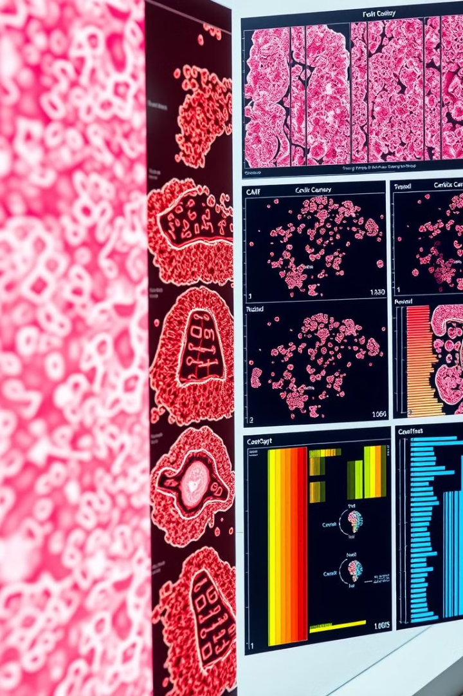
Generating CAMs for Cervical Cancer Images
1
Datasets
2
Pre-trained CNNs
Herlev (918 images) and SIPaKMeD (3500+ images) for training CNNs.
Fine-tune VGG16 and ResNet50 on cervical cancer images.
3
Step-by-step Guide
Load model, preprocess image, compute CAM using TensorFlow or PyTorch.

Slide 6
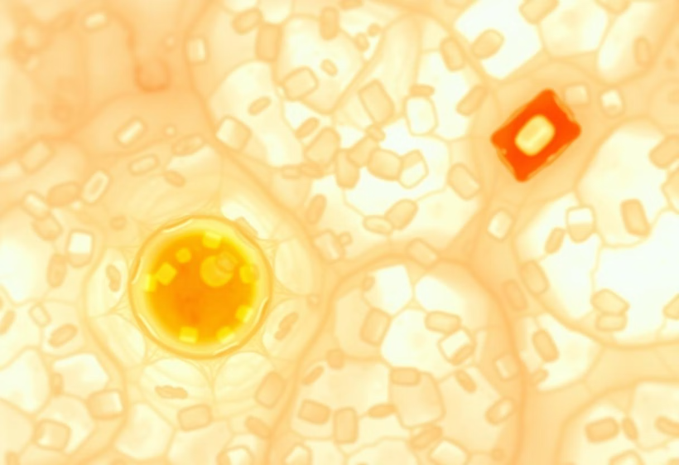
Interpreting CAMs in Cervical Cancer Detection
Highlights dysplasia and cancerous cell regions
Detects false positives and negatives
Illustrates different cervical cancer subtypes
CIN III lesion CAM highlights HPV-infected cells

Slide 7
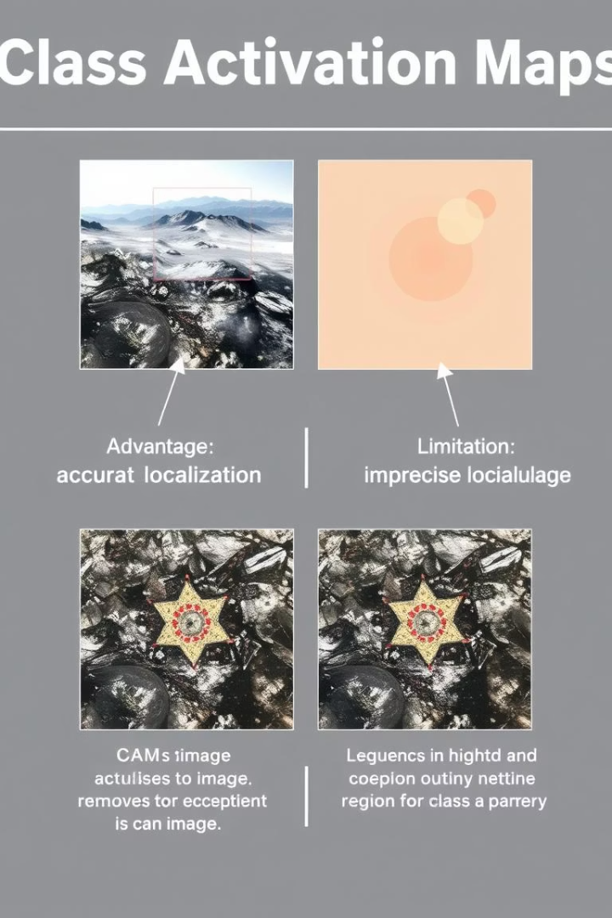
Advantages and Limitations of CAM
Advantages
Limitations
Simple, intuitive, fast, and computationally efficient technique
Requires CNN access; resolution limited by upsampling; gradient issues
Alternatives
Grad-CAM and Score-CAM offer enhanced visualization quality

Slide 8
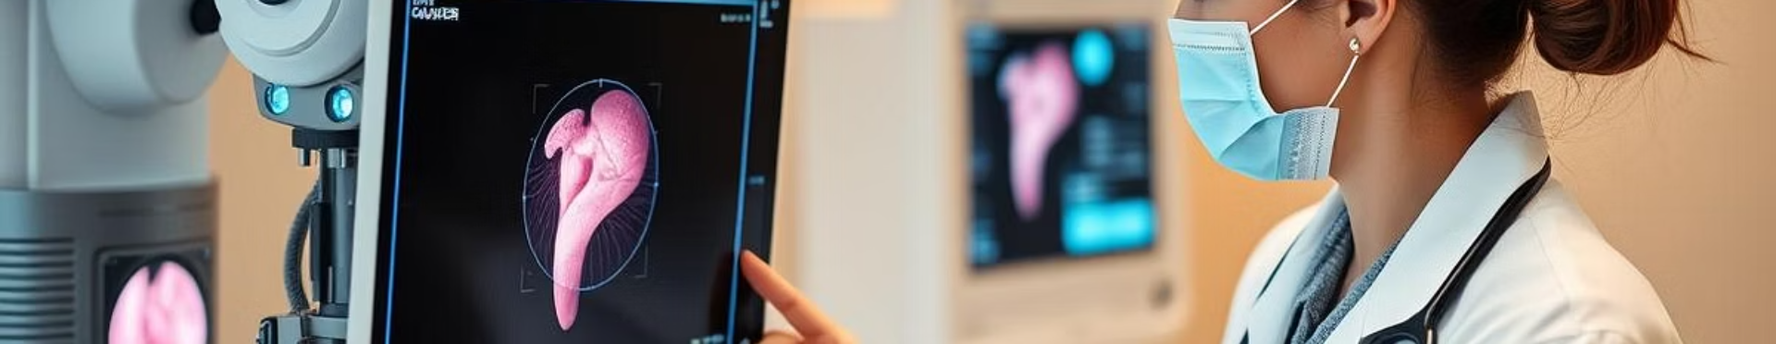
Conclusion: CAMs for Trustworthy AI in Cervical Cancer Diagnostics
CAMs visualize CNN decisions, improving clinician trust and understanding.
They support integrating AI tools safely into clinical workflows.
Future work focuses on advanced visualization and real-time applications.

